Slide 1
Celebrating 10 years of Australian generosity
Notes:
Insights into the evolving role of peer to peer to peer fundraising in philanthropy
The critical voice of Gen-Z in the future of giving
Opportunities for partnership in moments of crisis

Slide 2
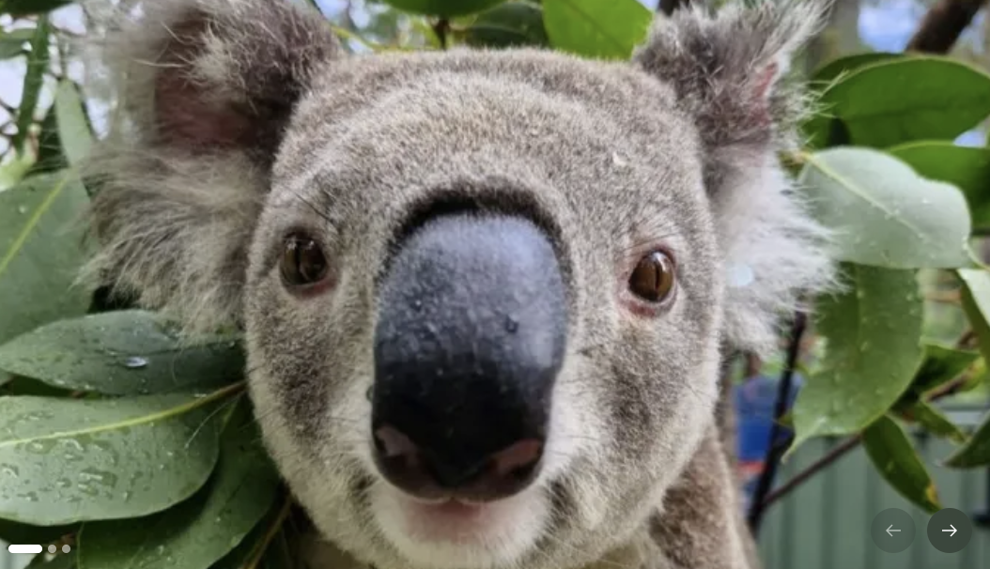
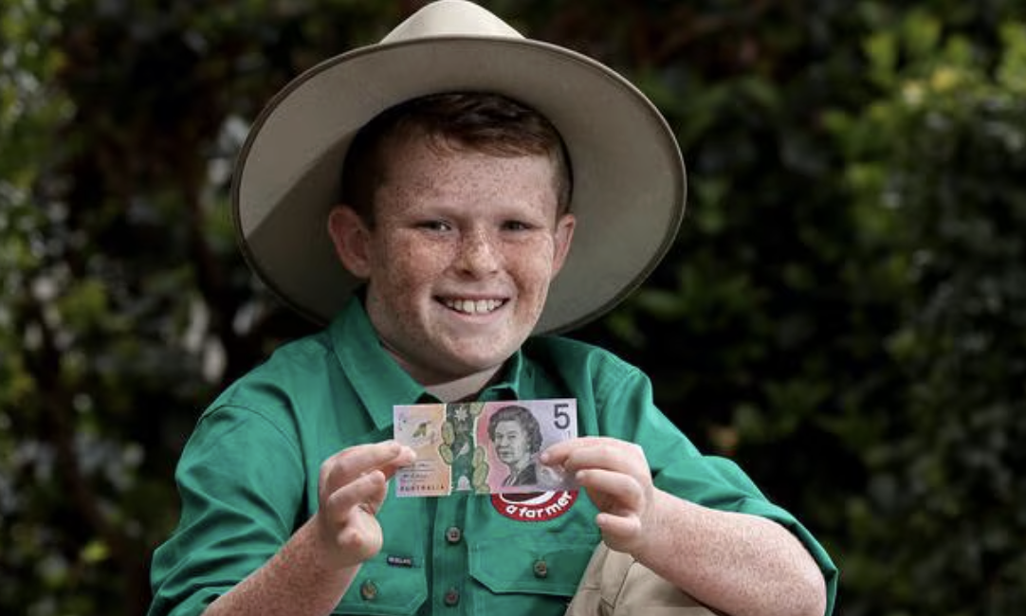
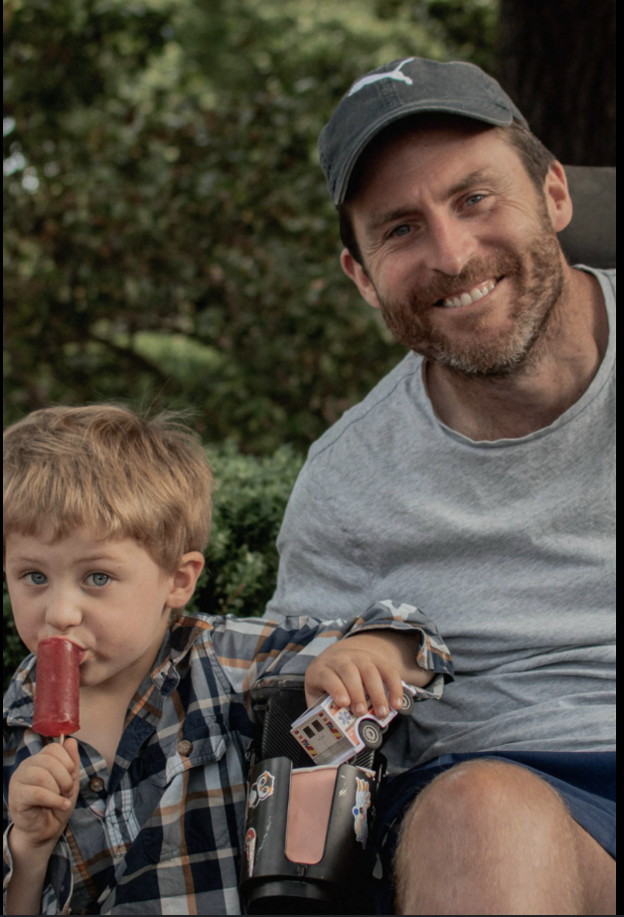
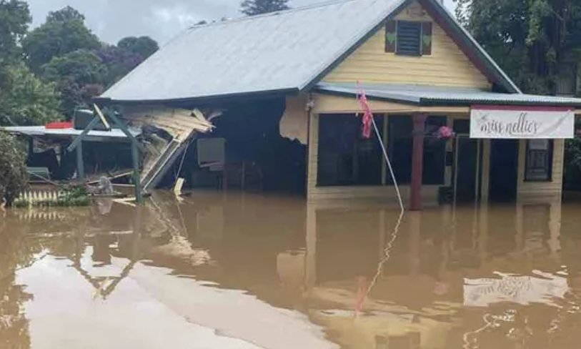
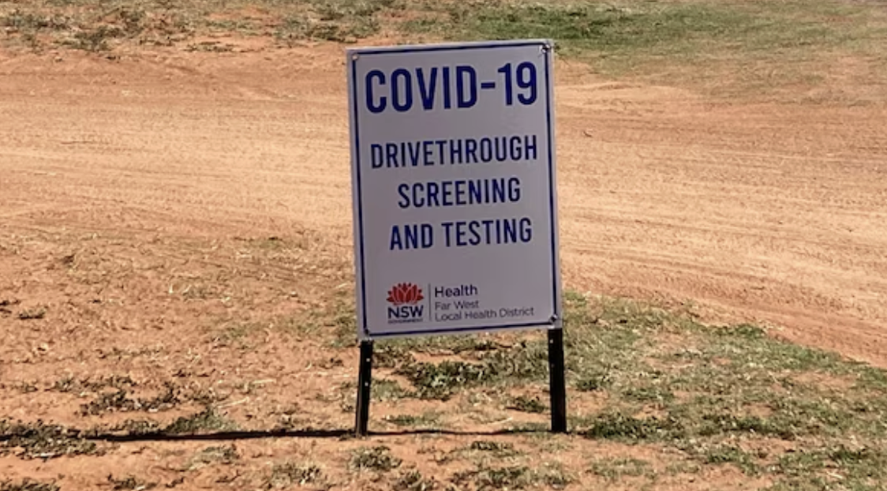
10 years of Australian generosity
GoFundMe Australia
Notes:
Speaker notes:
Introduction, why we are here
GoFundMe in Australia to date

Slide 3
10 years of Australian generosity
GoFundMe Australia
$1.1 billion AUD has been donated
800,000 fundraisers published
1 in 3 Aussies have used GoFundMe to help one another
A third of donors are repeat donors
1 in 3
$1.1B
Aussies have now used GoFundMe
AUD has been donated to Australian causes
33%
800,000
of donors are repeat donors
fundraisers published
Notes:
Speaker notes:
Zoom out for global context
With more than $40 billion from a community of 200M and two donations per second, we’ve become the largest fundraising platform in the world

Slide 4
15 years of global giving
GoFundMe around the world
15 years
A global community of 200 million
Over $40 billion raised
1 in 3 repeat donors
Two donations every second
200M
Over $40B
global community
dollars raised
1 in 3
2 donations
repeat donors
are made every second
Notes:
Speaker notes:
Zoom out for global context
With more than $40 billion from a community of 200M and two donations per second, we’ve become the largest fundraising platform in the world

Slide 5
Building for the next generation

Slide 6

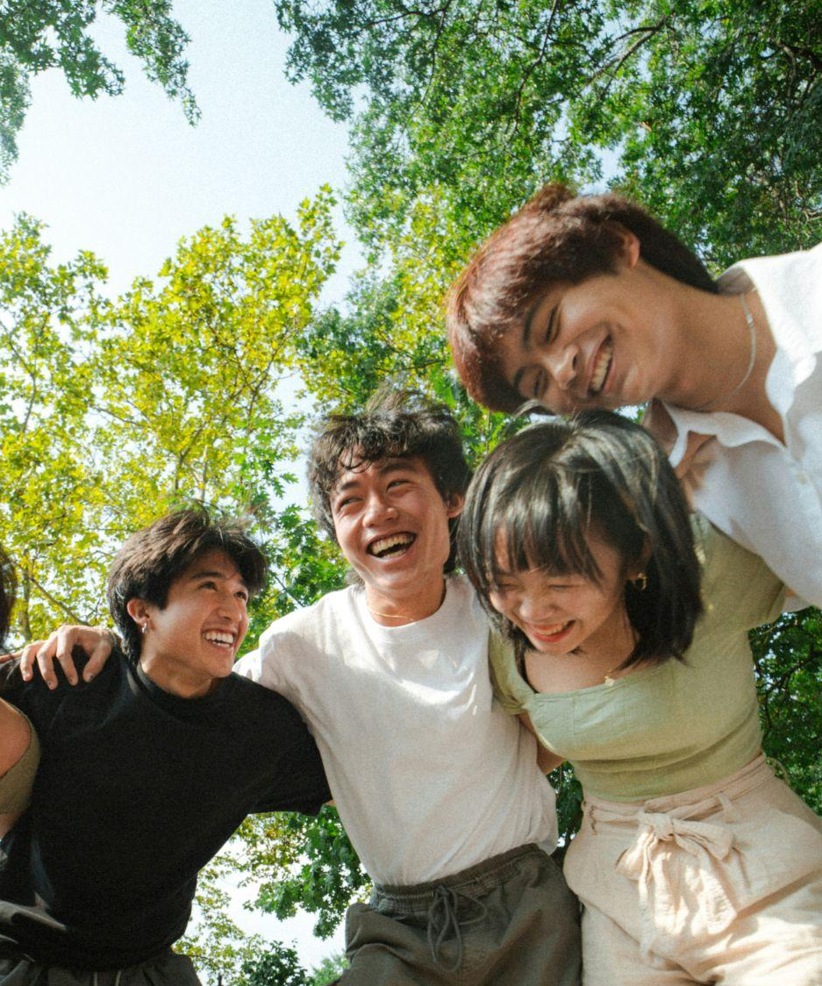

The shifting nature of giving
Gen Z
Gen Z sees social media as both a way to give and advocate for causes
They’re 10x more likely than Boomers to share donations online, with nearly half believing people should do so to inspire others
The majority of Gen Z and Millennials already follow an impact creators online, with one in four Gen Zers saying they’ve been motivated to donate because of a social media creator
Over half of Gen Z say they would trust impact creators to make donations on their behalf

Slide 7
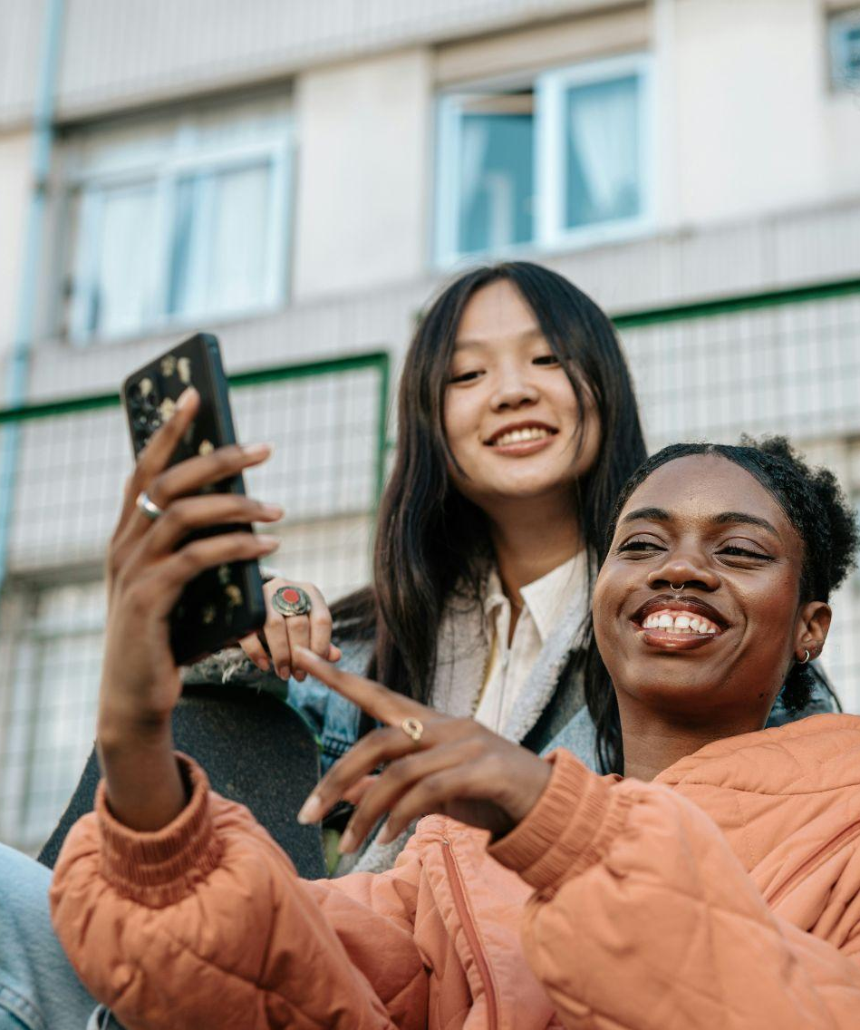
An entry point to charitable giving
GoFundMe Australia
A quarter of all Australians (23%) said their first ever experience of charitable giving was through GoFundMe
This rises significantly to almost 40% of Gen Z donating for the first time via GoFundMe
It is a significant evolution that Australian Gen Z are experiencing the power of help for the first time through GoFundMe
Over 40% of Aussies say that since making that first donation, they have gone on to be more charitable

Slide 8
The next decade
GoFundMe Australia
Insights
10 years has provided us a wealth of insights to now unlock help at scale
Drawing on insights from millions of fundraisers, drive innovation that boosts participation in charitable giving
We are focused on building more valuable tools to help unlock Australian generosity at scale
Innovation
GoFundMe’s AI-powered fundraising features have been used more than 50 million times
GoFundMe’s impact-sharing technology has inspired over 18 million donations in the last year
Notes:
By using the intelligence gained from millions of successful fundraisers, we are uniquely positioned to fuel innovation for the sector and help grow participation in giving

Slide 9

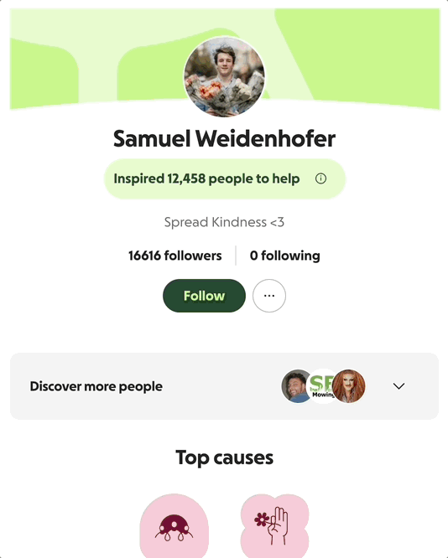
Innovating for next gen donors
Impact links

Slide 10
Community crisis response
Responding together in times of community crisis

Slide 11

Community crisis
& natural disaster
GoFundMe Australia
More than $1 billion has been raised on GoFundMe for natural disasters around the world
The largest Australian crises + natural disasters:
COVID-19 response [2020-2021]: $44M AUD
Black Summer Bushfires [Jan 2020]: $41M AUD
East Coast flooding [2022]: $17M
The largest global crises + natural disasters:
Middle East conflict: $500M USD
2025 US Wildfires: $400M USD
Ukraine War:

Slide 12
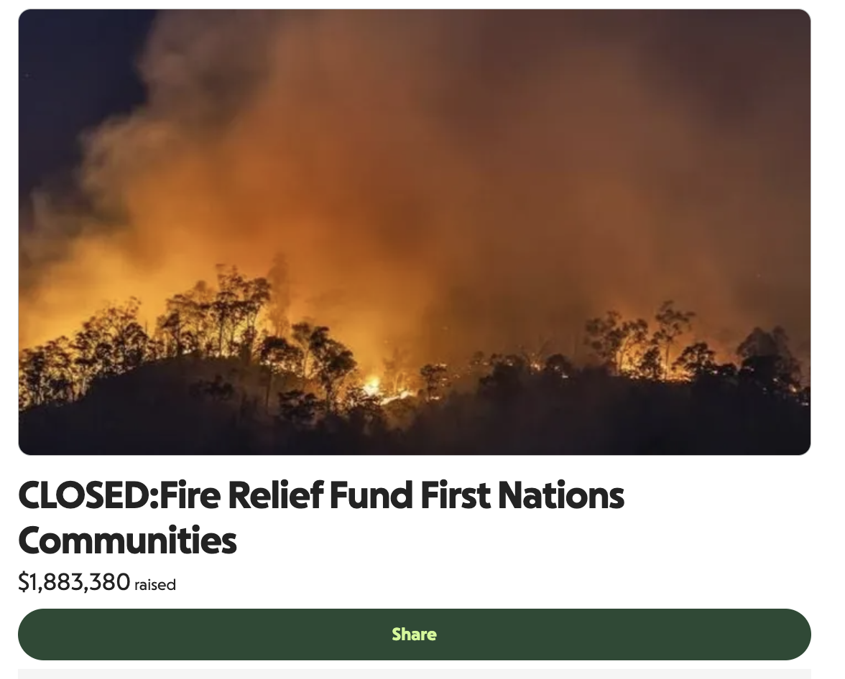
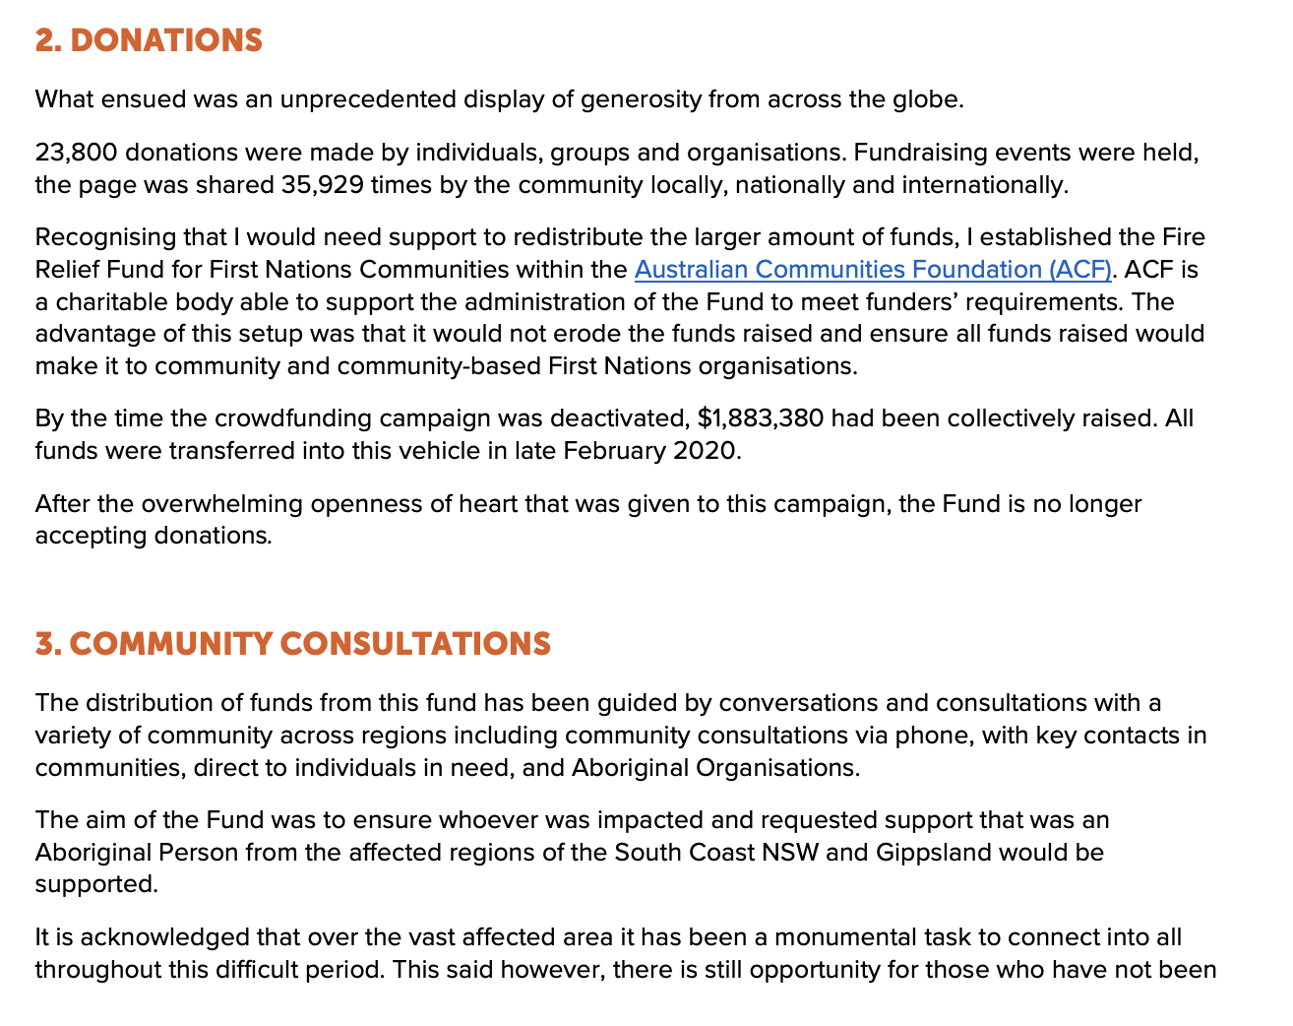
Partners in disbursement
GoFundMe Australia

Slide 13
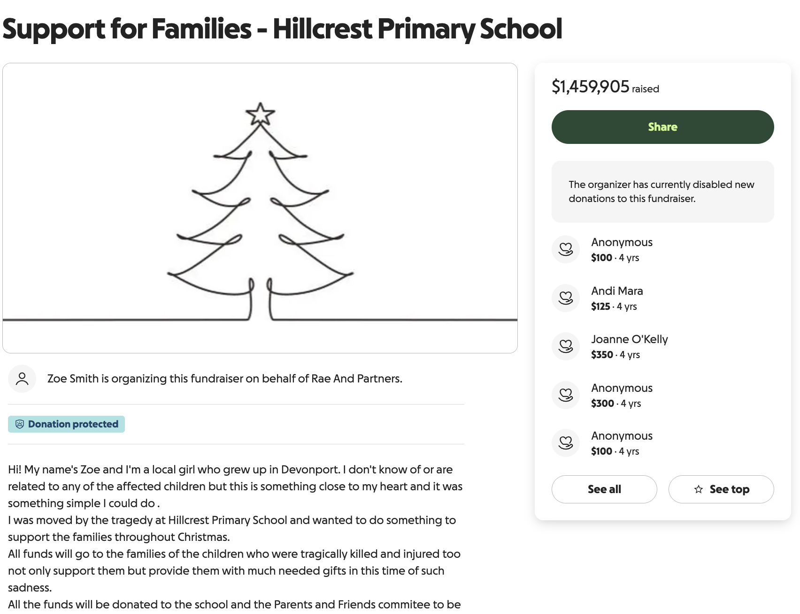
Supporting your community in moments that matter
GoFundMe Australia
Less than 12 hours after the traffic Hillcrest Primary School fatal jumping castle incident, a former student of the school launched a GoFundMe for the impacted families.
Over $1.4M was raised for both the families and victims.
We were able to work closely with the Lord Mayor’s Charitable Fund, established weeks later, to redirect these generous donations to a central community fund.

Slide 14
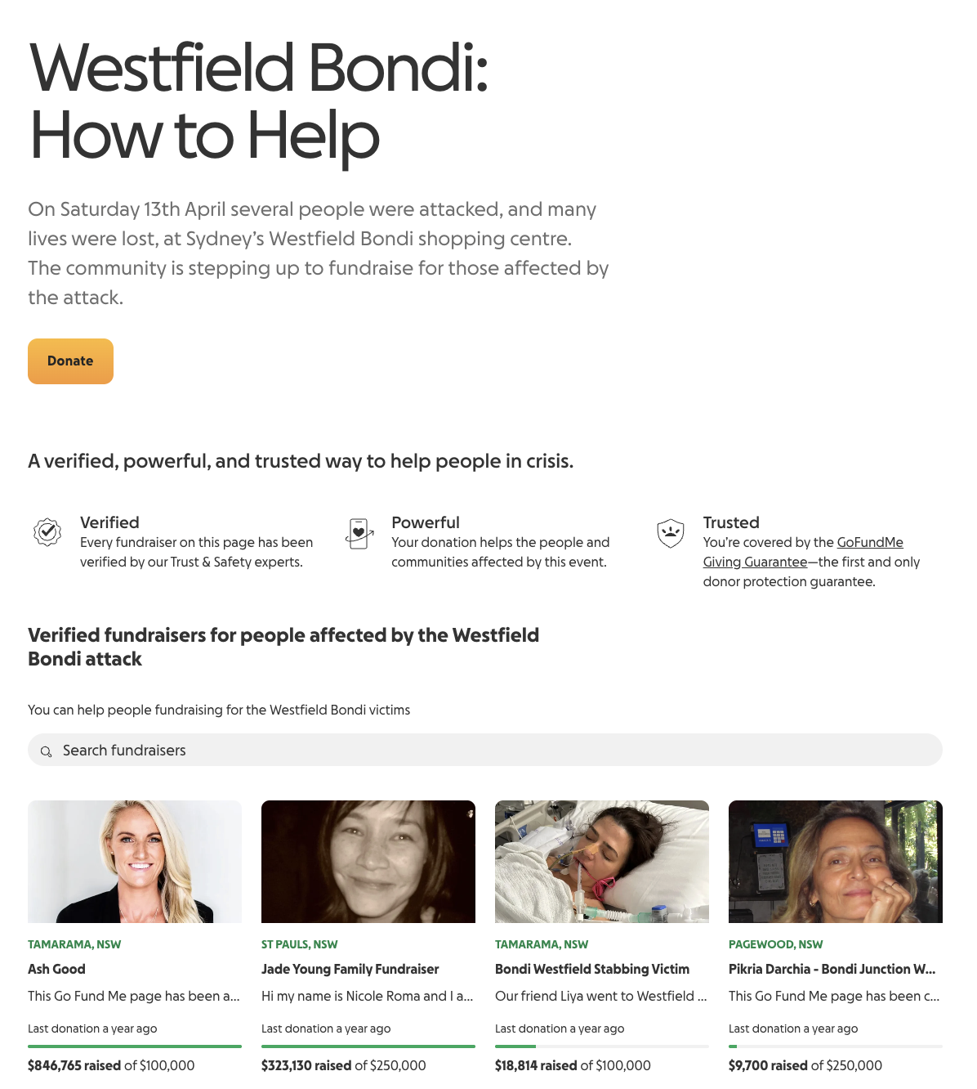
Supporting your community in moments that matter
GoFundMe Australia
Within 24 hours of the fatal Westfield Bondi attacks, GoFundMe pages for the victims raised over $1M.
Connecting with the Local Mayor of Waverley to ensure she was across our vetting processes, helped capture local generosity and bring together the community in the wake of such loss.

Slide 15
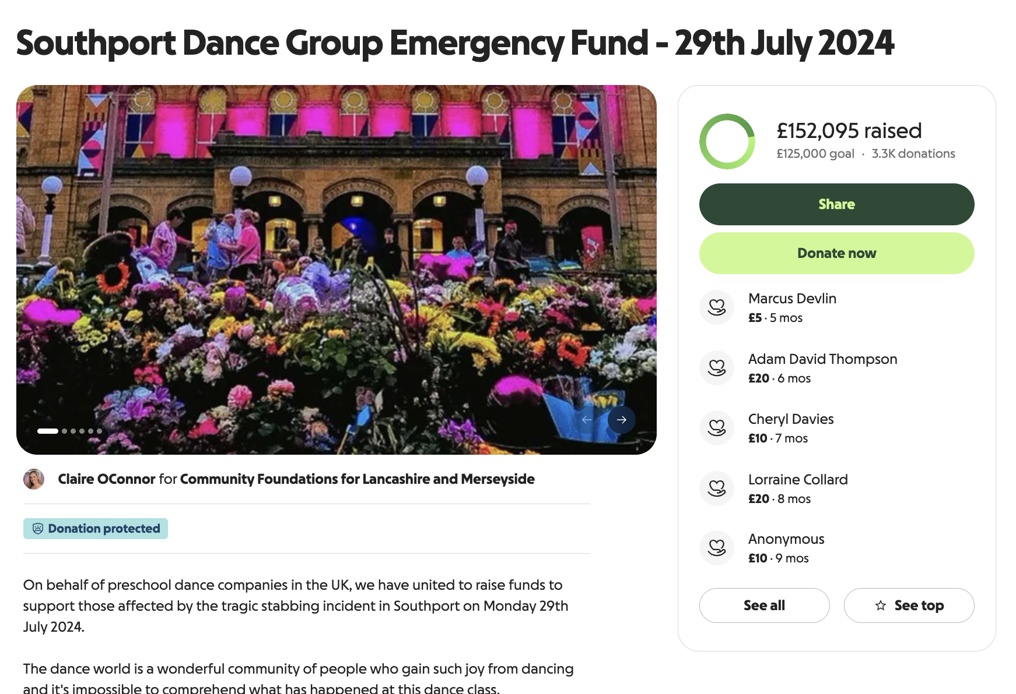
UK Community Foundations
GoFundMe Australia
Establishing new models and partnerships with networks of Community Foundations around the world
This enables us to mobilise donors, capture generosity, disperse funds and put donations to work quickly in times of community crisis

Slide 16
Global innovation
Making donor-advised funds more accessible

Slide 17
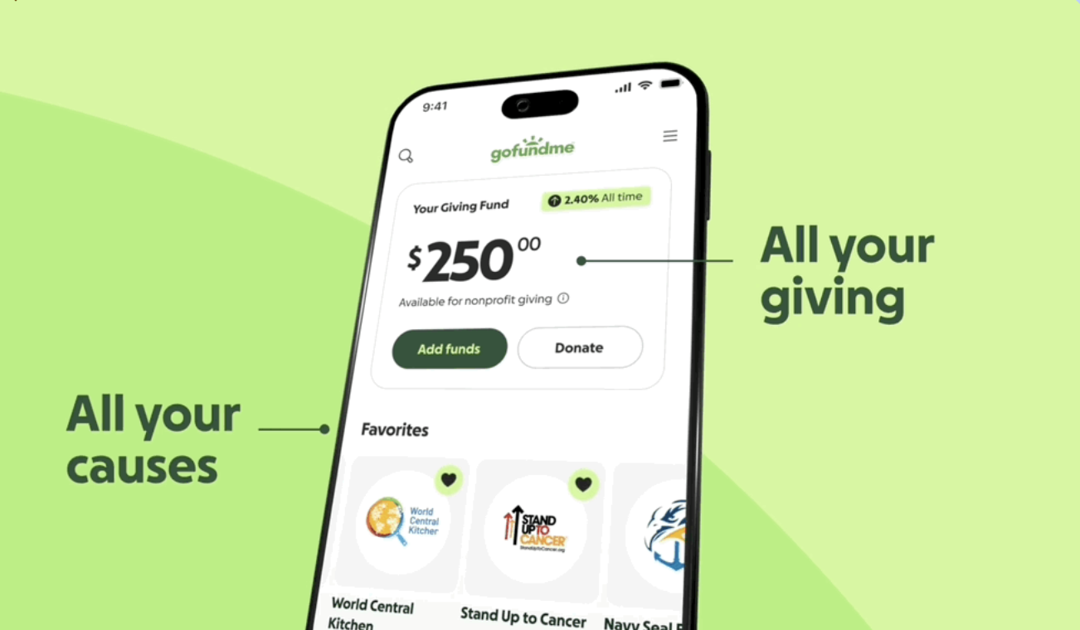
US Giving Funds
GoFundMe Australia

Slide 18
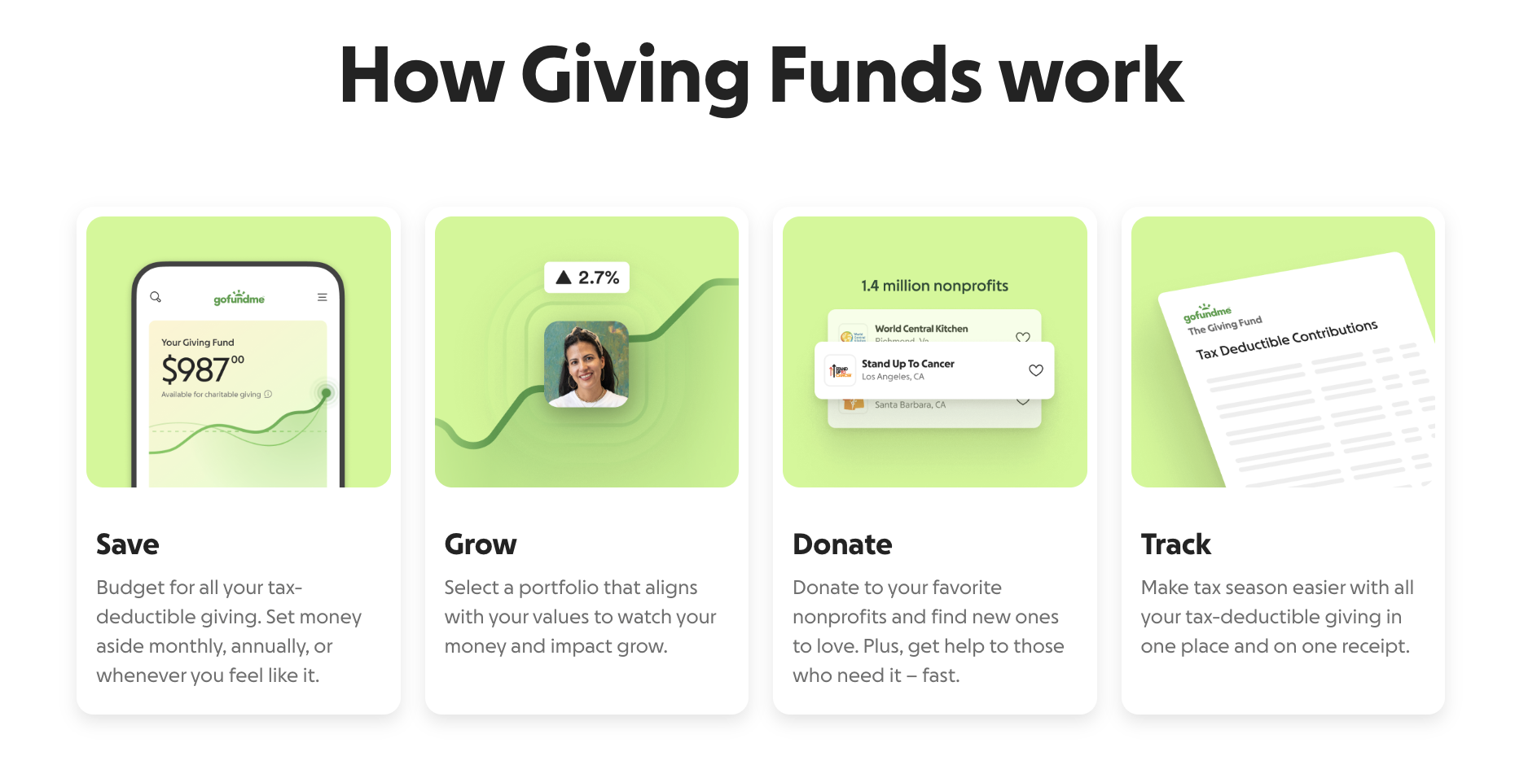
GoFundMe Australia

Slide 19
Thank you!
You can reach the GoFundMe Australia team to explore partnerships, crisis response, or other collaboration opportunities via
Australia@gofundme.com

